Slide 1
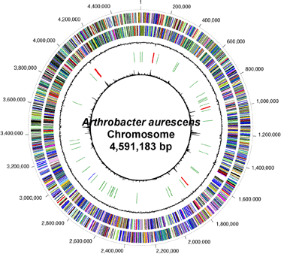
Genome Practical Microbial Genomics

Slide 2
What Time Is It? ....Its Genome Time!

Slide 3
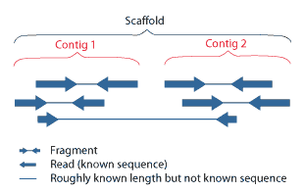
Sequence data
Contigs: overlapping DNA fragments (sequence reads) that form a consensus region of DNA
Paired-end sequencing

Slide 4
Analyzing GC Content
Whole genomes can be distinguished by GC content in some cases
These differences can arise via lateral gene transfer

Slide 5
Exercise 1
Paste the sequence data for each genome respectively
Save the output

Slide 6
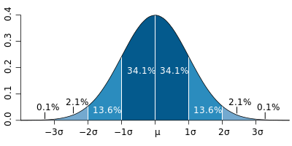

Ex1 cont’d
Normally distributed data
95% - 2 stdev
Determine the mean(μ)
Determine standard deviation (σ)

Slide 7
from sequence import readFastaFile
def countGC(sequence):
Gs=sequence.count('G')
Cs=sequence.count('C')
per=float(Gs+Cs)/len(sequence)
return round(per,2)
def meanGC(GCcounts):
mean=float(sum(GCcounts))/len(GCcounts)
return round(mean,2)
def stdev(values,mean):
"""This is NOT the sample standard deviation """
vals=[]
for i in range(len(values)):
vals.append((values[i]-mean)**2)
stdev=math.sqrt((1/float(len(values)))*sum(vals))
return round(stdev,2)
#read in fasta files
seqs = readFastaFile('Genome1.fasta')
seqs2 = readFastaFile('Genome2.fasta')
seqs3 = readFastaFile('Genome3.fasta')
#Count GC in each contig
counts=[]
for seq in seqs: #change seqs
count=countGC(seq)
counts.append(count)
#(Repeat for other genomes)
print "GENOME1 Processing"
G1mean= meanGC(counts)
print "mean",G1mean
std= stdev(counts,G1mean)
print "stdev",std
upper=G1mean+2*std
print "upper",round(upper,2)
lower=G1mean-2*std
print "lower",round(lower,2)

Slide 8
Table Exercise 1
Genomes | Mean | Standard Dev. | Upper limits | Lower limits
Genome1 | Mean1 | Stdev1 | Upper1 | Lower1
Genome2 | Mean2 | Stdev2 | Upper2 | Lower2
Genome3 | Mean3 | Stdev3 | Upper3 | Lower3

Slide 9
Taxonomic identification (16S rRNA)
1) Present in all bacteria as a multigene family
2) The function of 16S rRNA genes have not changed over time (changes in sequence) can accurately determine evolution
3) 16S rRNA gene is large enough for gene sequencing

Slide 10
Exercise 2
RNAmmer Creates a HMM from the structural alignments to predict rRNA genes

Slide 11
Exercise 2 cont’d
Green genes → Compare → BLAST

Slide 12
Exercise 3
The reading frame
Why? (think about how we select the best reading frame)

Slide 13
Exercise 4
What is the protein (hypothetical proteins are acceptable)
What organism is it from

Slide 14
Exercise 5
A) common pathways
B)
Think about the organism (day to day activities, energy requirements)
Link pathways to key factors that allow the organism to thrive

Slide 15
Exercise 6
Look up each organism
Noting differences
Consider the pathways that are different between the organisms;
Link the pathways to the differences
Use references to scientific journals

